Slide 1

House Plan Generation
B.Praveen Kumar-2022179050
K.Surendar-2022179014
Deepan Raj-2022179053

Slide 2

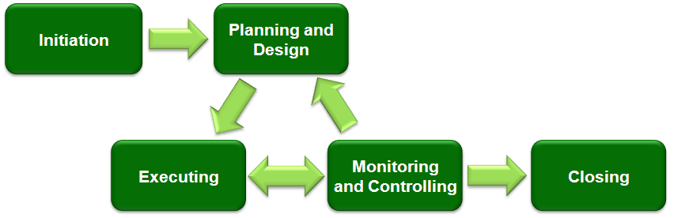
Introduction
Brief Introduction to the Project
The increasing importance of generative models in architectural design.
Motivation and Importance
Streamlining floor plan generation for architects and designers.
Objective of the Project
Developing a hybrid model using GANs and Autoencoders for diverse and realistic floor plan generation.
This Photo by Unknown author is licensed under CC BY-SA.

Slide 3
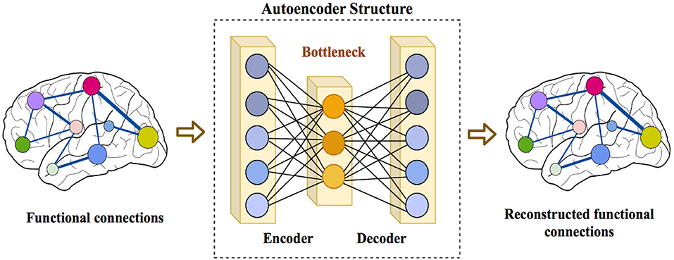
Project Overview
Overview of the Hybrid GAN-Autoencoder Approach
Combining reconstruction and generative capabilities for optimal results.
Role of Autoencoder and GAN in Floor Plan Generation
Autoencoder for feature capture, GAN for diversity and realism
This Photo by Unknown author is licensed under CC BY.

Slide 4
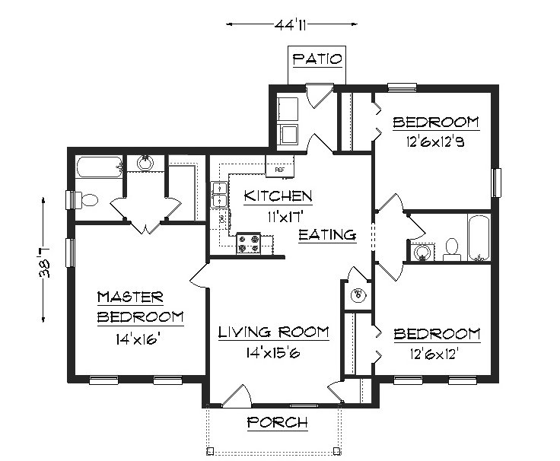
Dataset
Overview of the Dataset
Diverse collection of floor plan images.
Importance of Diverse Floor Plan Images
Ensuring model generalization and creativity.
Data Collection and Preprocessing
Cleaning procedures, resizing, and ensuring dataset quality.
This Photo by Unknown author is licensed under CC BY-SA.

Slide 5
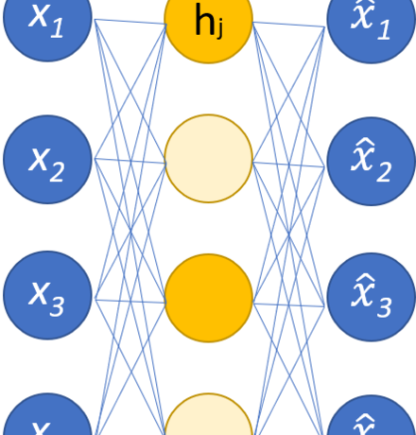
Auto encoder Architecture
Explanation of Autoencoder Components:
Encoder: Capturing essential features.
Latent Space: Abstract representation.
Decoder: Reconstructing floor plans.
This Photo by Unknown author is licensed under CC BY-SA.

Slide 6
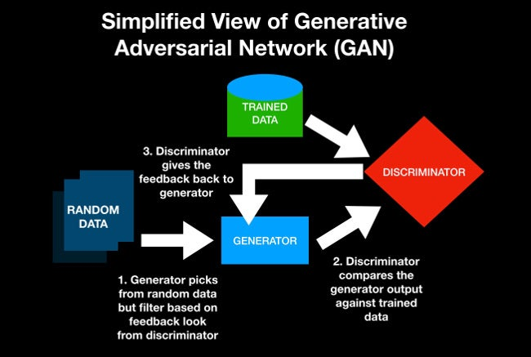
GAN Architecture
Explanation of GAN Components:
Generator: Creating diverse floor plans.
Discriminator: Assessing realism.
Integration with Autoencoder
Connecting Autoencoder's encoder to GAN's generator for a hybrid approach.
This Photo by Unknown author is licensed under CC BY-SA.

Slide 7
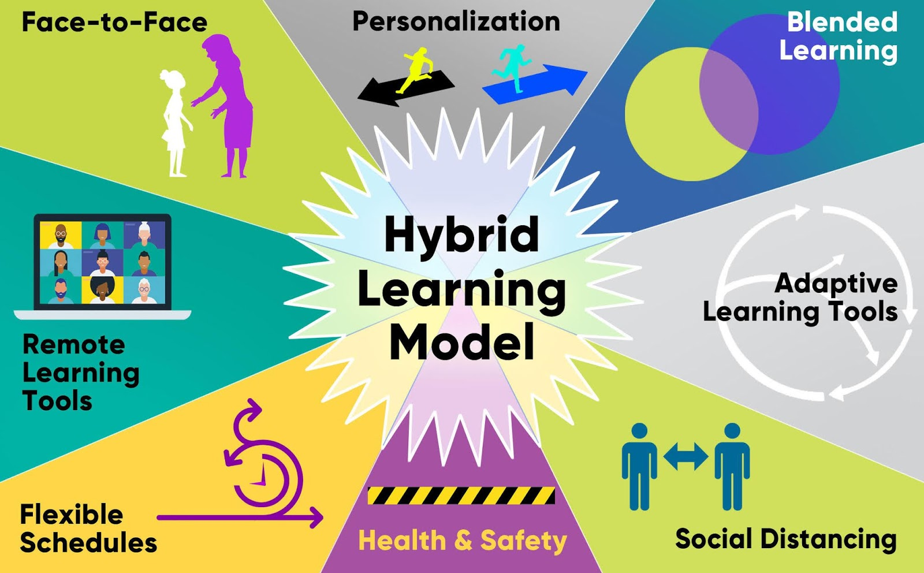
Hybrid Model Integration
How Autoencoder and GAN Components are Combined
Seamless integration for a balanced generative model.
Importance of Hybrid Architecture
Leveraging strengths for diverse and realistic floor plans.
This Photo by Unknown author is licensed under CC BY.

Slide 8
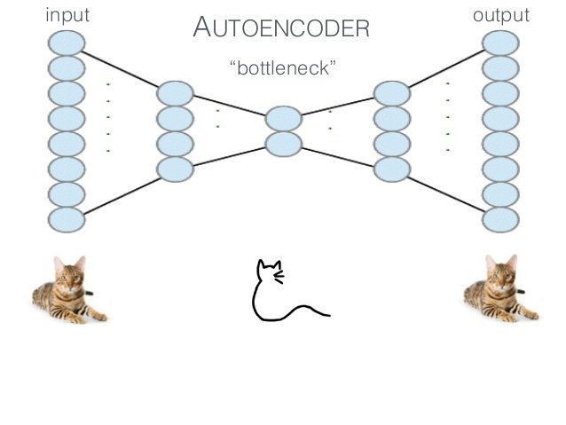
Training Process
Adversarial Training Overview
Generator vs. Discriminator competition.
Alternating Training between Autoencoder and GAN
Ensuring both reconstruction and generation capabilities are refined.
Hyperparameter Settings
Mention key hyperparameters and their role in training.
This Photo by Unknown author is licensed under CC BY.

Slide 9
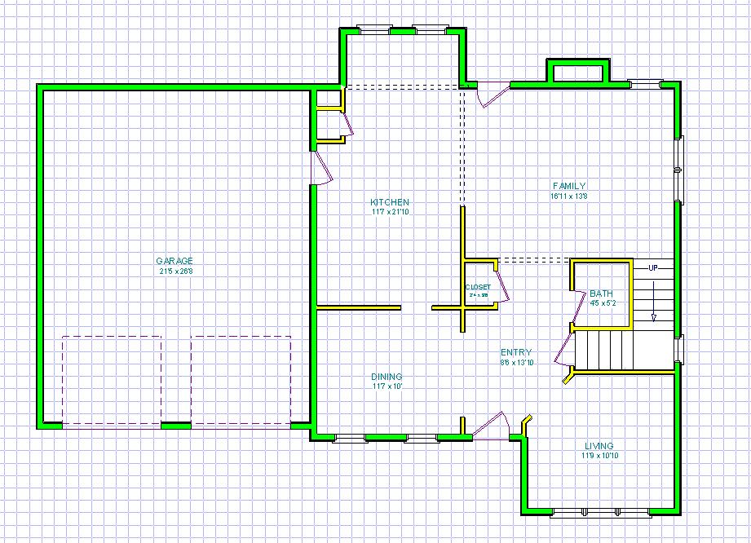
Results - Generated Floor Plans
Visual Showcase of Real vs. Generated Floor Plans
Side-by-side comparisons.
Highlighting Diversity and Realism
Discussing the variation and fidelity of generated floor plans.
This Photo by Unknown author is licensed under CC BY-SA.

Slide 10

Results - Realism and Detail
Close-up Comparison of Real and Generated Floor Plans
Emphasizing the model's ability to capture intricate architectural details.
Capturing Architectural Features
Illustrating how the model reproduces room arrangements, door placements, and window configurations.

Slide 11
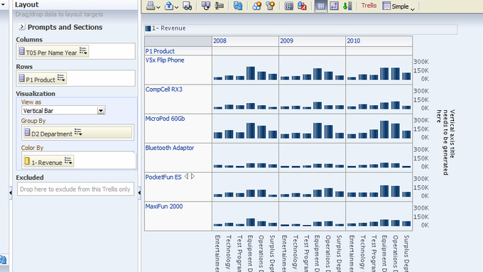

Results - Evaluation Metrics
Summary of Quantitative Metrics
MSE, Diversity Measures, etc.
Visualizing Results
Charts or graphs showcasing the model's performance on evaluation metrics.
This Photo by Unknown author is licensed under CC BY-SA.

Slide 12
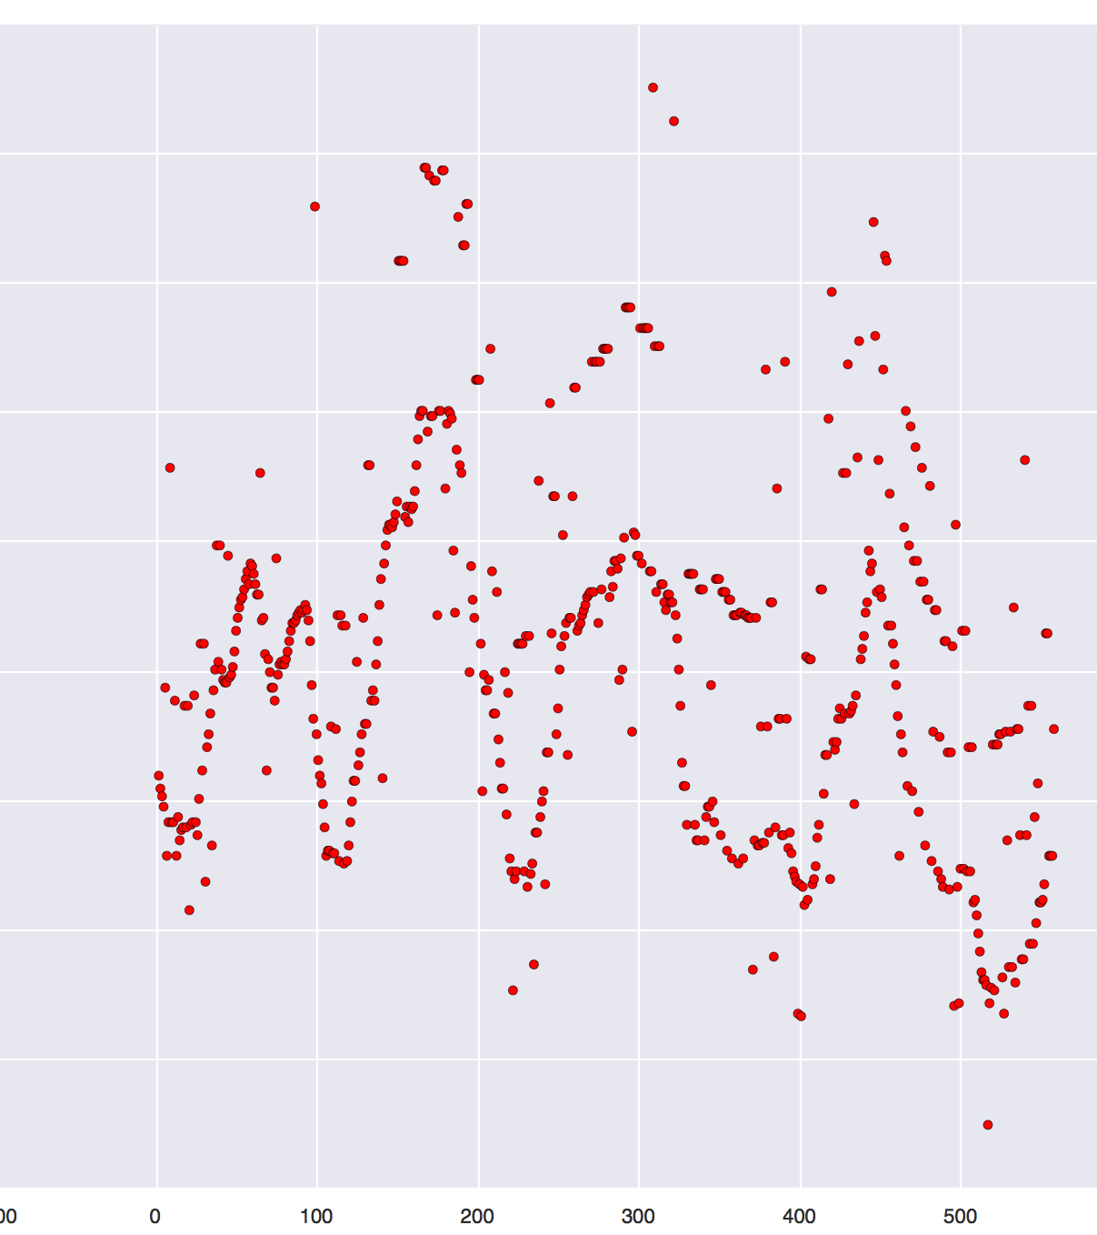
Challenges Encountered
Training Time and Resource Requirements
Strategies employed to address computational challenges.
Evaluation Metric Selection
Discussing the challenges in selecting appropriate metrics.
Dataset Limitations
Acknowledging potential biases or limitations in the dataset.
This Photo by Unknown author is licensed under CC BY-SA.

Slide 13
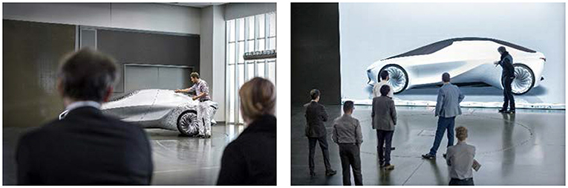
Future Work
Enhancing Creativity in Generation
Strategies for making the model more creative.
User-Centric Design Improvements
Ongoing efforts to incorporate user feedback for improvements.
Robustness and Generalization Strategies
Exploring ways to make the model more robust to diverse architectural styles.
This Photo by Unknown author is licensed under CC BY.

